Slide 1


Taiwan(Taichung district) gerrymandering observation
Current status: (Total :8)
DPP*5, KMT*3 (ignore other partisan votes)
Government re-arrange distribution in 2006 (11 districts to 5 + (x-1,500,000)/300,000 districts
Goal:
Re-arrange districts: 2nd district is weird now(connect to coast area and mountain area
Benefit to DPP: re-arrange district distribution to let DPP win
Benefit to KMT: re-arrange district distribution to let KMT win
Issues:
How to automatically transfer adjacent areas to be edges?
How to define constraint of lb population
Any hint about setting constraint or obj to let one partisan party win more

Slide 2
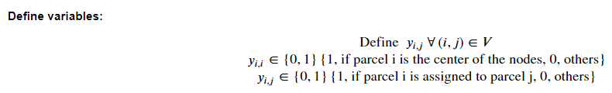
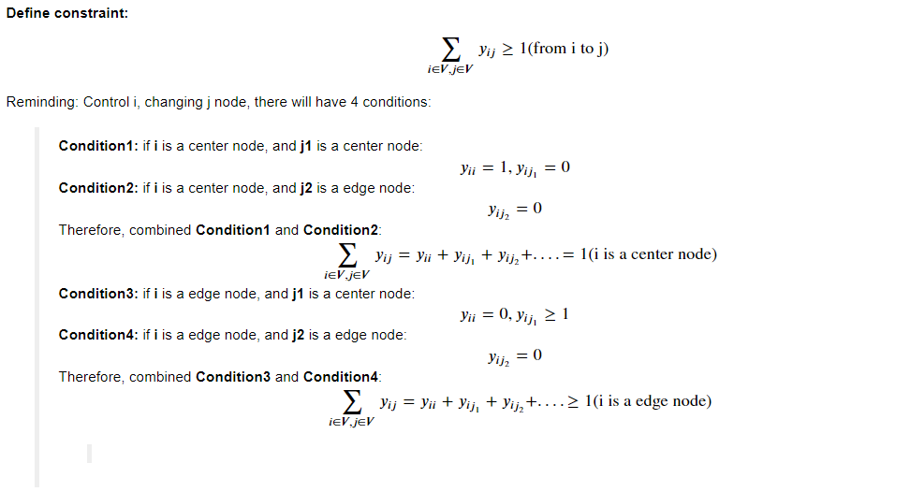
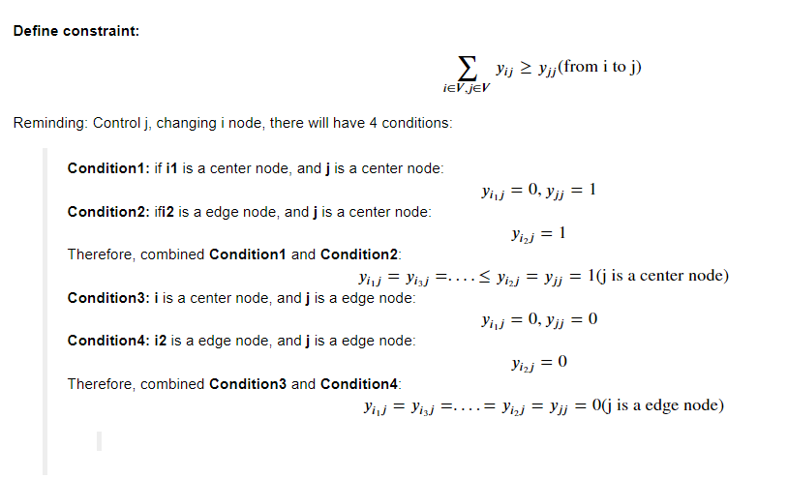
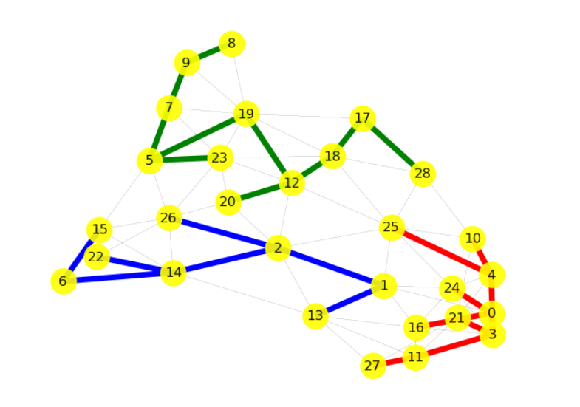
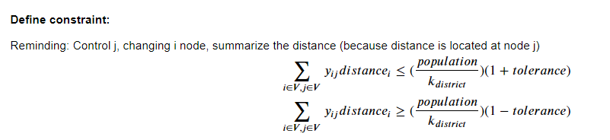
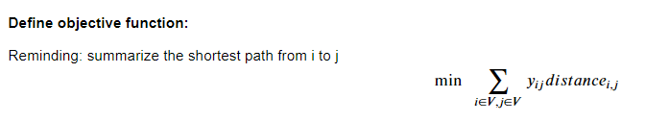
Rearrange district
Result
If k= 3

Slide 3
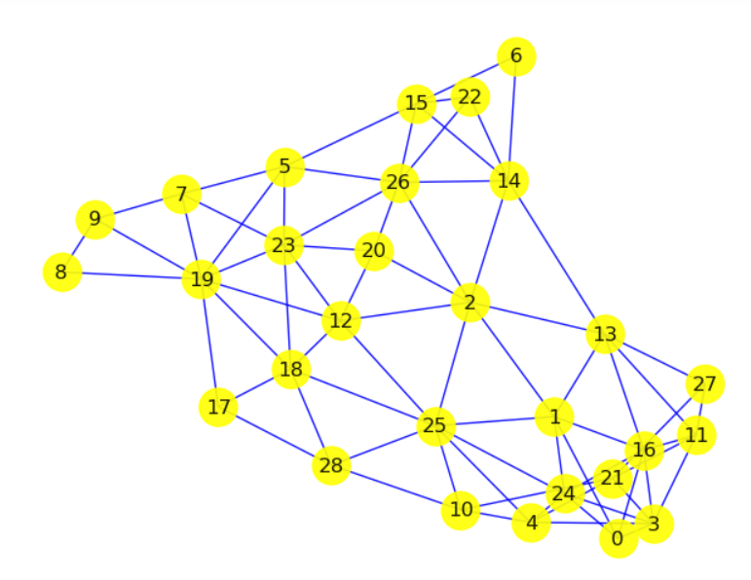
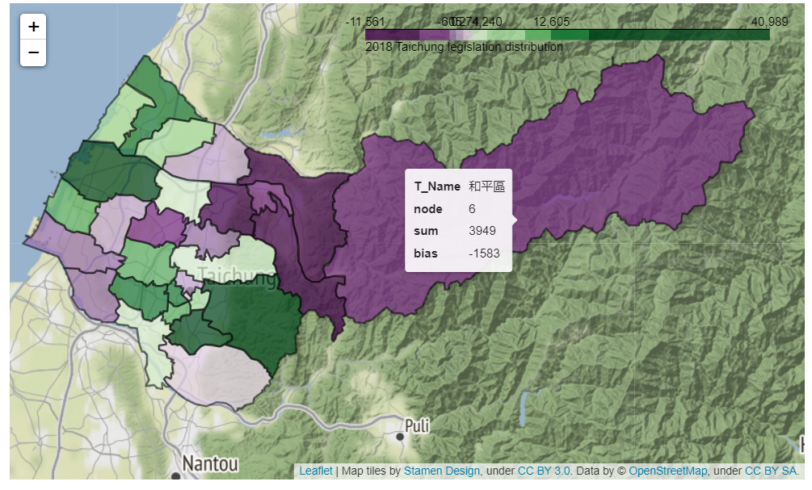

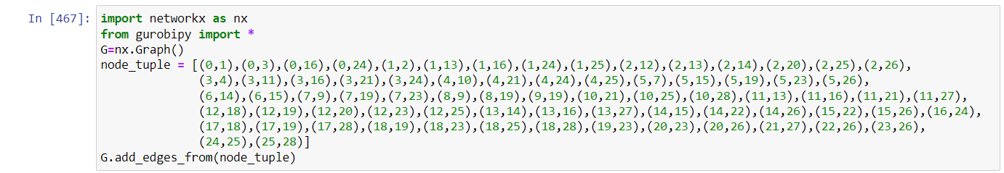
Adjacent areas→ connected edges
Issue1

Slide 4

How to define the LB of the population?
Issue2
k1
j1
k2
k1
k2
j1
j5
j2
j5
i1
j2
i2
j6
i1
j3
i2
j6
j3
j7
j4
j7
j4
k1 = sum of the j1~j4 and i1 population
k2 = sum of the j5~j7 and i2 population
k1 = k2 = 0
Can define a LB
If only if LB = 0

